Slide 1

Financial Market and the firm
Debindra Bhandari

Slide 2




Basic Structure: 3 Principle sets of Players
Borrowers
Savers (Investors)
Financial Institutions (Intermediaries)

Slide 3
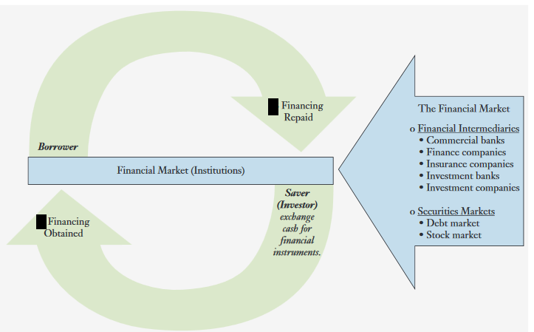
Financial Market, Institution and Circle of Money

Slide 4


Accepts Deposits
Grants Loans

Slide 5
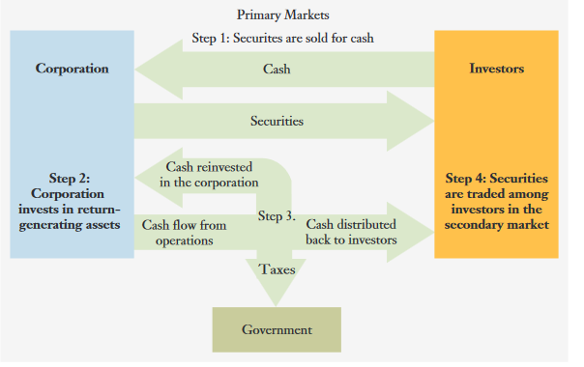
Security Markets: A link between Corporations and Investors

Slide 6

Debt Securities
Equity Securities
Common Stock
Preferred Stock
Notes:
Preferred shareholders receive their dividends before any dividends are distributed to the common stockholders
In case of Bankruptcy, the firm’s creditors (bondholders) get paid first, followed by the preferred stockholders, and anything left goes to the common stockholders.

Slide 7


Stock Market
A public market in which the stock of companies is traded.

Slide 8
THANK YOU

